Slide 1
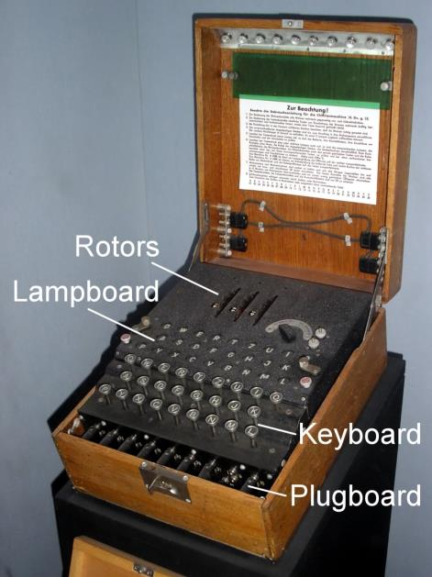
Old machine for encryption

Slide 2
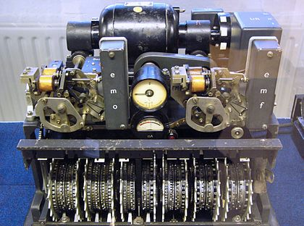
Old machine for encryption
Notes:
Picture: Lorenz SZ42 machine
Source: Wikipedia
Used by: German Army in WWII
Note: More sophisticated than the Enigma code
This was the reason the Colossus computer was built

Slide 3
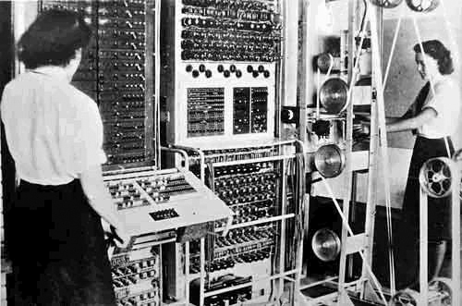
Old photo
Notes:
Name: Colossus
World’s first: electronic digital programmable computer
Colossus
Mark I contained 1500 thermionic valves (tubes)
Mark II contained 2400 valves – 5x faster and simpler to operate than Mk I

Slide 4
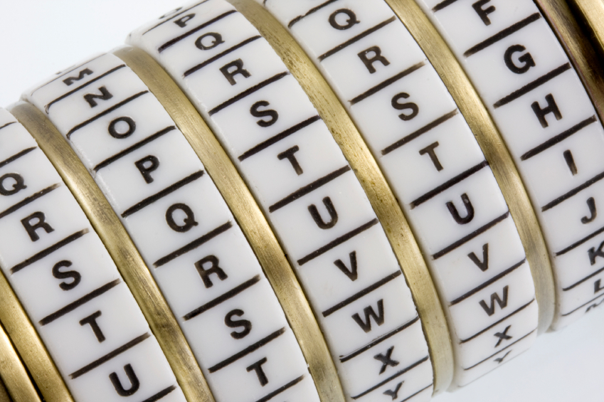
Cryptography
Corporate Computer Security, 4th Edition
Randall J. Boyle & Raymond R. Panko
Chapter 3

Slide 5
Learning Objectives (Week 4)
Explain the concept of cryptography.
Describe symmetric key encryption and the importance of key length.
Explain negotiation stage.
Explain initial authentication, including MS-CHAP.
Describe keying, including public key encryption.

Slide 6
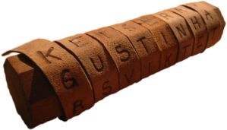
Introduction
Some Early History:
1900 BC: Egyptians use non-standard hieroglyphics
475 BC: Spartans of Greece develop the scytale
50 BC: Julius Caesar using a simple cipher for military and government communications.
725 AD: Abu `Abd al-Rahman al-Khalil ibn Ahmad ibn `Amr ibn Tammam al Farahidi al-Zadi al Yahmadi wrote a (now lost) book on cryptography
1466 AD: Leon Battista Alberti, the Father of Western cryptography worked on polyaphabetic substitution and a ciper disk.
1623 AD: Sir Francis Bacon described one of the first uses of steganography

Slide 7




3.1: Cryptography
Cryptography is the use of mathematical operations to protect messages traveling between parties or stored on a computer
Confidentiality means that someone intercepting your communications cannot read them
???

Slide 8
3.1: Cryptography
Confidentiality is only one cryptographic protection
Authentication means proving one’s identity to another so they can trust you more
Integrity means that the message cannot be changed or, if it is change, that this change will be detected
Known as the CIA of cryptography

Slide 9
3.1: Cryptography
Encryption for confidentiality needs a cipher (mathematical method) to encrypt and decrypt
The cipher cannot be kept secret
The two parties using the cipher also need to know a secret key (or keys)
A key is merely a long stream of bits (1s and 0s)
The key (or keys) must be kept secret
Cryptanalysts attempt to crack (find) the key

Slide 10
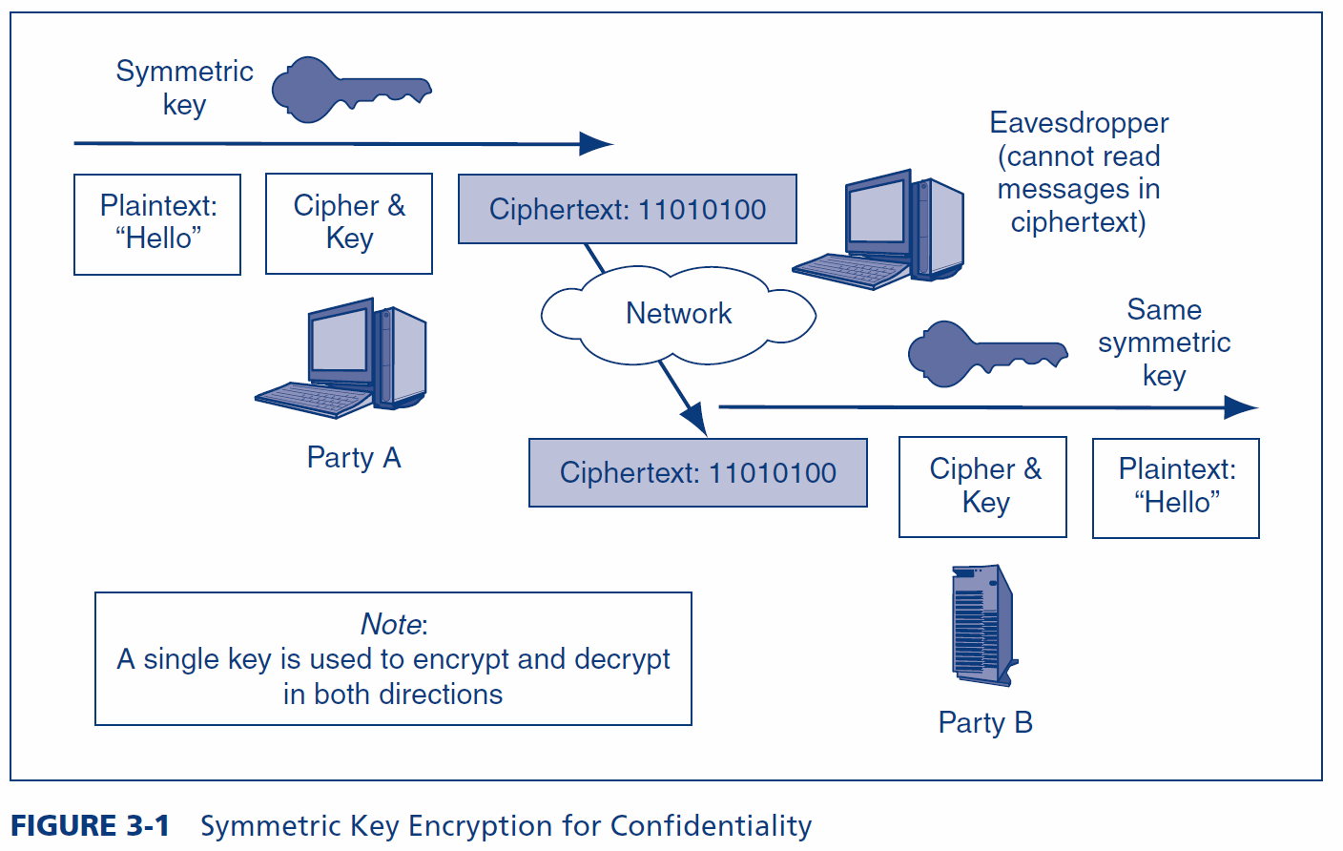
3.1: Symmetric Key Encryption for Confidentiality

Slide 11
3.1: Example Symmetric Key Cipher (Fig. 3-2)
Plaintext | Key | Ciphertext
n | 4 | r
o | 8 | w
w | 15 | l
i | 16 | …
s | 23 | …
t | 16 | …
h | 3 | …
e | 9 | …
t | 12 | …
i | 20 | …
m | 6 | …
e | 25 | …
+4
n o p q r
This is a very weak cipher.
Real ciphers use complex math.

Slide 12
3.1: Types of Ciphers
Substitution Ciphers
Substitute one letter (or bit) for another in each place
The cipher we saw in Figure 3-2 is a substitution cipher
Transposition Ciphers
Transposition ciphers do not change individual letters or bits, but they change their order
Most real ciphers use both substitution and transposition

Slide 13
3.1: Transposition Cipher
 | Key (Part 1)
Key (Part 2) | 1 | 3 | 2
2 | n | o | w
3 | i | s | t
1 | h | e | t
Key = 132 231

Slide 14
3.1: Ciphers versus Codes
Ciphers can encrypt any message expressed in binary (1s and 0s)
This flexibility and the speed of computing makes ciphers dominant for encryption today
Codes are more specialized
They substitute one thing for another
Usually a word for another word or a number for a word
Codes are good for humans and may be included in messages sent via encipherment

Slide 15
3.1: Key Length and Exhaustive Search Time
Key Length in Bits | Number of Possible Keys
1 | 2
2 | 4
4 | 16
8 | 256
16 | 65,536
40 | 1,099,511,627,776
56 | 72,057,594,037,927,900
112 | 5,192,296,858,534,830,000,000,000,000,000,000
112 | 5.1923E+33
168 | 3.74144E+50
256 | 1.15792E+77
512 | 1.3408E+154
Each extra bit
doubles the number of keys
Shaded keys are
Strong symmetric keys (>=100 bits)

Slide 16
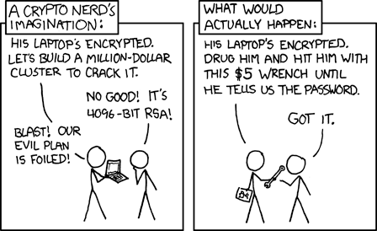
Exhaustive Search vs. Weakest Link
Notes:
Cartoon: XKCD.com

Slide 17
3.1: Key Length and Exhaustive Search Time
Public key/private key pairs (discussed later in the chapter) must be much longer than symmetric keys to be considered to be strong because of the disastrous consequences that could occur if a private key is cracked and because private keys cannot be changed frequently.
Public keys and private keys must be at least 512 to 1,024 bits long.

Slide 18
3.2: Major Symmetric Key Encryption Ciphers
 | RC4 | DES | 3DES | AES
Key Length (bits) | 40 bits or more | 56 | 112 or 168 | 128, 192, or 256
Key Strength | Very weak at 40 bits | Weak | Strong | Strong
Processing Requirements | Low | Moderate | High | Low
RAM Requirements | Low | Moderate | Moderate | Low
Remarks | Can use keys of variable length | Created in the 1970s | Applies DES three times with two or three different DES keys | Today’s gold standard for symmetric key encryption

Slide 19
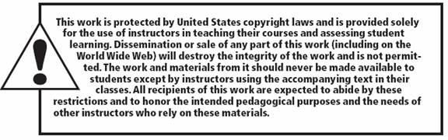
Copy right statement
All rights reserved. No part of this publication may be reproduced, stored in a retrieval system, or transmitted, in any form or by any means, electronic, mechanical, photocopying, recording, or otherwise, without the prior written permission of the publisher. Printed in the United States of America.
Copyright © 2010 Pearson Education, Inc.
Publishing as Prentice Hall

